Slide 1

Comprehensive Digital Marketing
Project Work
[SUNFEAST ITC]

Slide 2
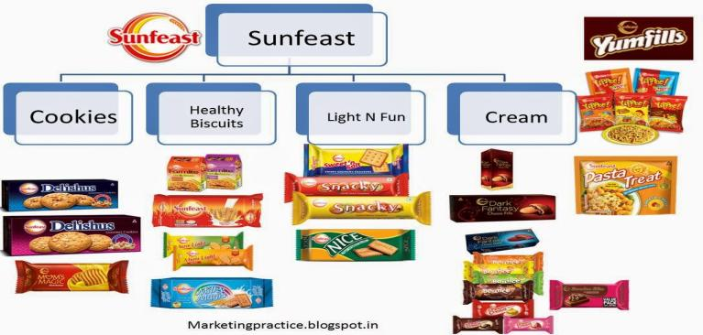
Part 1: Brand study, Competitor Analysis & Buyer’s/Audience’s Persona
1)Brand Identity: Brand name, logo, font, packing, size, slogan.

Slide 3
SUNFEAST MISSION AND VALUES
VALUES
MISSION
Sustain ITC's position as one of India's most valuable corporations through world-class performance, creating growing value for the Indian economy and the Company's stakeholders.
To enhance the wealth-generating capability of the enterprise in a globalizing environment, delivering superior and sustainable stakeholder value.

Slide 4

Analyse Brand Messaging: Sunfeast as a brand promotes a message of happiness, contentment, satisfaction, and pleasure.
Examine the brand's tagline: “Spread the Smile”
USP: High-quality packaging

Slide 5
Buyer's/Audience's Persona
USER PERSONA SUNFEAST
Table 01: DEMOGRAPHICS
Data points | Answers for [MARKET]
Name | AMAN SINGH
Age | 29
Occupation | Marketing Manager
Annual income | ₹70,000
Marital status | Married
Family situation | Two children (ages 5 and 8)
Location | SHRIHARIPURAM, [MARKET]

Slide 6
Table 02: USER DESCRIPTION
Aman Singh, aged 29, is a married Marketing Manager with an annual income of ₹70,000. he lives in a shriharipuram area in [MARKET] and has two children, aged 5 and 8.
Table 03: PSYCHOGRAPHICS
Table 04: SHOPPING BEHAVIORS
Data points | Answers for [MARKET]
Personal characteristics | Ambitious, creative, tech-savvy
Hobbies | Yoga, cooking, painting, gardening
Interests | Digital marketing trends, healthy living, sustainable brands
Personal aspirations | Career growth, work-life balance
Professional goals | Lead successful marketing campaigns
Pains | Lack of personal time, traffic congestion
Main challenges | Balancing family and career responsibilities
Needs | Convenient and healthy snacks
Dreams | Owning a countryside retreat with family
Data points | Answers for [MARKET]
Budget | Moderate, willing to pay for quality products
Shopping frequency | Bi-weekly for groceries, monthly for non-essential items
Preferred channels | Supermarkets, online marketplaces
Online behavior | Reads product reviews, compares prices online
Search terms | "Healthy snacks for kids", "easy family meals"
Preferred brands | Sunfeast, Nature's Best, HealthyBites
Triggers | Discounts, new product launches
Barriers | High product pricing, limited availability of products

Slide 7
Competitor Analysis
Competitors | Name | Quality | Market share | USP
Competitor1 | BRITANNIA |  | 20.00% | India's very own bakery and dairy products brand that is trusted for its quality.
Competitor2 | PARLE |  | 37.45% | Introducing products and categories to India that have not been experienced before.
Competitor3 | UNIBIC |  | 26.55% | Wide range of new and innovative products
Competitor4 | PATANJALI |  | 10.00% | Providing milk biscuits at affordable rates

Slide 8
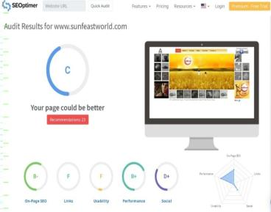
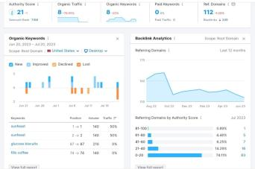
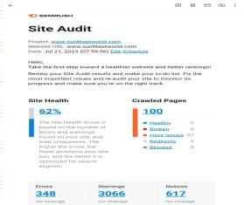
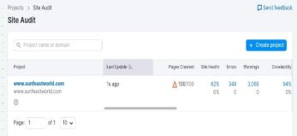
SEO AND KEYWORD RESEARCH
SEO AUDIT-
An SEO audit is the process of evaluating how well your website is optimized for search engines. It identifies errors that can prevent your site from ranking well and opportunities that can help you rank better.
SEO Audit for SUNFEAST
Website- www.sunfeastworld.com
seo - https://www.seoptimer.com/www.sunfeastworld.com
seo - https://www.semrush.com/seo/12762094

Slide 9
KEYWORD RESEARCH-
Keyword research is the process of finding and analyzing search terms that people enter into search engines with the goal of using that data for a specific purpose, often for search engine optimization (SEO) or general marketing. Keyword research can uncover queries to target, the popularity of these queries, their ranking difficulty, and more.
Research Objectives-
Defining our Target Audience- Before we can conduct any keyword research, we need to know who is our target audience is. By understanding our audience’s demographics, interests, and behaviours, we can identify the keywords that are most relevant and valuable to them.
Establishing our Brand’s Unique Selling Proposition- Our unique selling proposition (USP) is what sets our brand apart from our competitors. By defining our USP, we can identify the keywords that highlight our brand’s unique qualities and value proposition.
Identifying our Competitors- By examining their content and keyword research strategies, we can identify the keywords that they are neglecting or not ranking well for.
Conducting Effective Keyword Research- It helps us to identify the words and phrases that people use to find our website or content.
Utilizing Keyword Research Tools- There are many keyword research tools available, such as Google Keyword Planner, SEMRush, and Ahrefs. These tools enable us to identify relevant keywords, analyse their search volume, and evaluate their competition and difficulty.

Slide 10
BRAINSTORM SEED KEYWORDS-
Brainstorming a list of seed keywords based on our own knowledge, customer feedback, competitor analysis, or industry trends.
Keywords analysis -
Keyword | Country & Language | Position | Total Searches | Estimated Traffic
sunfeast | INDIA /ENG | 1 | 9,900 | 3,009
sunfeast | INDIA /HIN | 1 | 9,900 | 3,009
sunfeast biscuits | INDIA/ENG | 3 | 14,800 | 1,440
sunfeast biscuits | INDIA /HIN | 3 | 14,800 | 1,440
biscuits sunfeast | INDIA / ENG | 4 | 14,800 | 975
sunfeast biscuit | INDIA / ENG | 4 | 14,800 | 975
itc full form | INDIA /ENG | 40 | 74,000 | 155
sunfeast company | INDIA /ENG | 1 | 480 | 145
sunfeast company | INDIA / HIN | 1 | 480 | 145
itc biscuits | INDIA/ ENG | 5 | 1,900 | 89

Slide 11
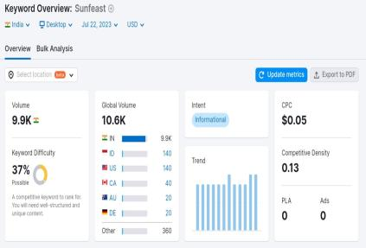
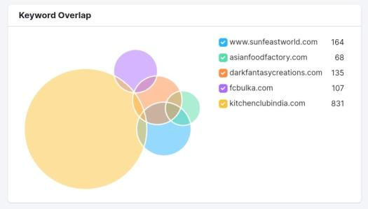
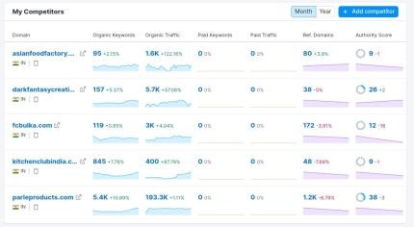
ANALYSE COMPETITORS KEYWORDS
Competitors
www.asianfoodfactory.com - Asian Food
www.darkfantasycreation.com – Dark Fantasy
www.fcbulka.com – FcBulka
www.kitchenclubindia.com – Kitchen Club India
www.parleproducts.com – Parle Products

Slide 12
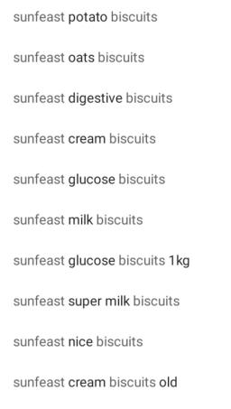
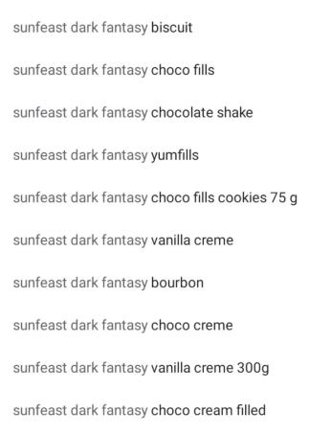
LONG TAIL KEYWORD-
Long-tail keywords are longer and more specific keyword phrases that visitors are more likely to use when they're closer to a point of purchase or when they're using voice search. Most long-tail keywords have lower search volume than short or “head” keywords.
Long Tail Keywords for SUNFEAST-
sunfeast biscuits
sunfeast dark fantasy
sunfeast mango smoothie
sunfeast all rounder
is sunfeast dark fantasy halal
how to make sunfeast pasta
how to make sunfeast yippee pasta
how to make sunfeast pasta treat
how many biscuits in sunfeast dark fantasy
sunfeast products
itc biscuits
itc biscuits brands
itc biscuits list

Slide 13
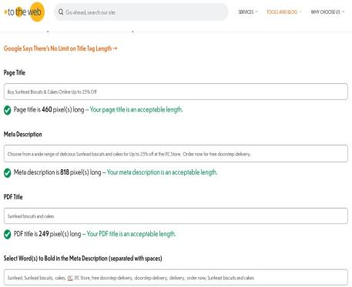
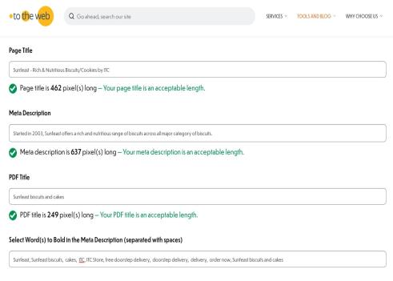
ON PAGE OPTIMIZATION-
On-page SEO (sometimes called on-site SEO) is the process of optimizing parts of your webpages so they rank higher on search engines and get more search engine traffic.
META TAG OPTIMIZATION AND CONTENT OPTIMIZATION-
Meta tags are invisible tags that provide data about your page to search engines and website visitors.
Content optimization is the process of making sure content is written in a way that it can reach the largest possible target audience. The process of optimizing content should include making sure associated keywords are present, adding meta and title tags, and relevant links.

Slide 14
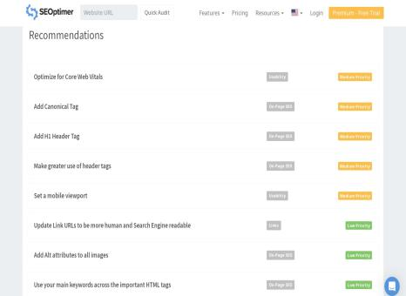
9. Organize and prioritize your keywords: Group your keywords into relevant categories or topics.
PROCESS FOR CONDUCTING KEYWORD RESEARCH
Here's a step-by-step guide on how to conduct keyword research:
10. Monitor and update regularly: Keyword research is an ongoing process.
1. Define your goals: Determine the purpose of your keyword research.
SEO RECOMMENDATIONS-
2. Brainstorm initial keyword ideas: Start with a brainstorming session to generate a list of relevant keywords.
Here are the SEO RECOMMENDATIONS provided by seoptimer.
3. Use keyword research tools: There are several keyword research tools available that can help you expand your initial list and gather valuable data.
4. Analyze search volumes and trends: Review the search volumes for the keywords you've gathered.
5. Consider keyword difficulty: Keyword difficulty refers to how challenging it is to rank for a specific keyword.
6. Focus on long-tail keywords: Long-tail keywords are longer and more specific phrases.
7. Evaluate competitor keywords: Analyze your competitors' websites to identify the keywords they are targeting.
8. Consider user intent: Think about the user's intent behind each keyword.

Slide 15
KEY INSIGHTS GAINED FROM THE KEYWORD RESEARCH PROCESS
CHALLENGES FACED DURING THE RESEARCH AND ANALYSIS-
Some of the common challenges faced during this phase include:
Here are some key insights gained from the keyword research process:
1. Keyword Competitiveness: Identifying high-volume keywords that are relevant to your business is essential, but some keywords may have high competition, making it difficult to rank well for them.
1. Search Volume: Understanding the search volume for specific keywords helps you prioritize which terms are more popular and likely to drive more organic traffic to your website.
2. Constantly Changing Search Algorithms: Search engines frequently update their algorithms, affecting how websites are ranked.
2. Keyword Relevance: Keyword research reveals which terms are most relevant to your business, products, or services.
3. Data Accuracy: The accuracy of data provided by keyword research tools is critical.
4. Understanding User Intent: Identifying the true intent behind a keyword can be tricky.
3. User Intent: By analyzing keywords, you can gain insights into the intent of users behind their searches.
5. Local SEO Considerations: For businesses targeting specific geographic locations, local SEO is vital.
4. Long-tail Keywords: Long-tail keywords often have lower search volumes but higher conversion potential.
6. Content Quality and Relevance: Even with the right keywords, if the content doesn't meet user expectations in terms of quality, relevance, and value, it may not perform well in search rankings.
5. Competitor Analysis: Keyword research allows you to identify the keywords your competitors are targeting.
6. Seasonal Trends: Certain keywords may experience fluctuations in search volume based on seasonal trends or events.
7. Link Building Complexity: Building high-quality backlinks is essential for SEO, but it can be challenging to acquire relevant and authoritative links from reputable sources.
7. Keyword Difficulty: Assessing keyword difficulty helps you understand the level of competition for specific terms.

Slide 16

JULY-2023 CONTENT CALENDAR
“ Spread the Smile ”
SUN | MON | TUES | WED | THURS | FRI | SAT
 |  |  |  |  |  | 1
2 | 3 CONTENT WRITING | 4 SOCIAL MEDIA MARKETING | 5 INSTAGRAM STORY | 6 LIVE ADVERTISING | 7 SEO | 8
9 | 10 COMPETITOR ANALYSIS | 11 E-MAIL MARKETING | 12 | 13 BLOG POST | 14 QUIZ | 15
16 | 17 | 18 KEYWORD RESEARCH | 19 | 20 | 21 VIDEO EDITING | 22
23 | 24 BRAND AWARENESS | 25 | 26 DESIGNS | 27 IDEA CREATION | 28 | 29
30 | 31

Slide 17
STRATEGY, AIM, AND IDEA
FIRST THE IDEA AND TARGET AUDIENCE WERE SELECTED
THE AIM WAS TO PROMOTE THE BRAND NAME
CREATION OF SOCIAL MEDIA CAMPAIGN
PREPARATION OF THEMES
BLOG WRITING
QUIZ AND SEMINAR
BRAND PREPAREDNESS
SOCIAL PRESENCE
E-MAIL MARKETING
QUESTIONNAIRE

Slide 18
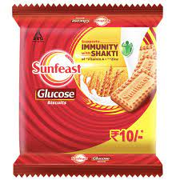
BLOG PAGE
Introduction: Welcome to the delightful world of Sunfeast, where every bite is designed to bring sunshine into your life! Established with a commitment to crafting scrumptious and innovative snacks, Sunfeast has become a household name across the globe. This blog will explore the journey, values, and mouthwatering products that make Sunfeast an irresistible choice for millions of snack enthusiasts.
The Sunfeast Story: The story of Sunfeast began with a vision to create snacks that transcend taste and elevate the snacking experience to new heights. Sunfeast quickly gained popularity from its humble beginnings due to its dedication to quality, authenticity, and innovation. Over the years, Sunfeast has grown into a trusted brand that stands tall amidst fierce competition in the snacking industry.
Commitment to Quality: At Sunfeast, the focus on quality is unwavering. Only the finest ingredients are chosen to ensure that each product delivers an exceptional taste experience. The company maintains stringent quality control measures throughout the production process, adhering to international standards. Every step is carried out with meticulous attention to detail, from sourcing raw materials to the final packaging.
Innovative Delights: Sunfeast takes pride in its ability to push the boundaries of snacking creativity. The brand constantly introduces new flavors and products that tantalize taste buds and cater to various preferences. Whether you crave savory or sweet, crispy or creamy, Sunfeast has an array of treats to satiate your desires.

Slide 19
INTERACTIVE QUIZ
1. What is the vision of Sunfeast?
a) To create innovative snacks for every occasion. b) To become the leading global snack brand. c) To bring sunshine into people's lives with every bite. d) To deliver quality products at affordable prices.
2. Which of the following is NOT one of Sunfeast's core values?
a) Quality b) Sustainability c) Innovation d) Profit-maximization
3. Sunfeast Yippee Noodles are a favorite among
a) Children b) Adults c) Both children and adults d) Elderly people
4. What makes Sunfeast Dark Fantasy cookies special?
a) They are made with exotic ingredients from around the world. b) They are filled with a luscious chocolate center. c) They are only available on special occasions. d) They are the healthiest cookies in the market.
5. Which Sunfeast product is perfect for those who prefer a healthier snacking option?
a) Sunfeast Yippee Noodles b) Sunfeast Mom's Magic cookies c) Sunfeast Farmlite Digestive Biscuits d) Sunfeast Dark Fantasy cookies
6. What does Sunfeast do as part of its corporate social responsibility (CSR) efforts?
a) Investing in marketing campaigns b) Supporting education, sustainability, and community welfare initiatives c) Maximizing profits for shareholders d) Expanding into new international markets

Slide 20
CHALLENGES ENCOUNTERED
Competition in the Snack Industry: The snack market is highly competitive, with numerous established players and new entrants vying for consumer attention. Sunfeast has had to differentiate its products and marketing strategies to stand out in this crowded space.
Changing Consumer Preferences: Consumer preferences and trends are constantly evolving. Sunfeast has to keep up with these changes to stay relevant and appeal to the ever-changing tastes and preferences of its target audience.
Health and Nutrition Concerns: In recent years, there has been a growing focus on health and nutrition. Consumers are becoming more conscious of what they eat, and there's an increasing demand for healthier snack options. Sunfeast has had to address these concerns and offer healthier alternatives without compromising on taste.
Distribution and Reach: Ensuring widespread availability of products is crucial for marketing success. Sunfeast has had to work on its distribution network to reach more consumers, especially in remote or untapped markets.
Brand Perception and Recognition: Building and maintaining a positive brand image is essential for long-term success. Sunfeast has had to invest in brand-building initiatives to enhance its perception and recognition among consumers.
Promotional Strategies: Crafting effective promotional strategies to engage consumers and create a buzz around products is a challenge. Sunfeast has had to invest in innovative marketing campaigns to capture consumer attention in a cluttered advertising landscape.
Social Media and Digital Marketing: With the rise of social media and digital platforms, brands need to be active online to connect with consumers effectively. Sunfeast has had to adapt its marketing efforts to make a mark in the digital space.
Seasonal and Regional Variations: Different regions may have unique preferences and seasonal demands for certain products. Sunfeast has had to tailor its marketing approach to cater to these variations effectively.
Regulatory Compliance: Adhering to various advertising and labeling regulations can be challenging for food brands. Sunfeast has had to ensure that its marketing materials comply with all relevant laws and guidelines.

Slide 21
LESSONS LEARNED
Understanding Consumer Preferences: Sunfeast would have realized the importance of continuously studying and understanding consumer preferences and behavior. By gathering valuable insights, the brand can tailor its products and marketing strategies to better meet the needs of its target audience.
Innovation is Key: The competitive snack market demands constant innovation. Sunfeast likely learned that introducing new and unique products, flavors, and packaging can create excitement among consumers and give the brand a competitive edge.
Balancing Taste and Health: Sunfeast has probably recognized the significance of offering a balance between taste and health in its product portfolio. Providing healthier snack options without compromising on flavor can attract health-conscious consumers.
Building Emotional Connections: Successful marketing goes beyond promoting products; it builds emotional connections with consumers. Sunfeast may have discovered the power of storytelling and creating campaigns that resonate with the emotions and aspirations of its customers.
Effective Communication: Clear and effective communication is vital for brand success. Sunfeast might have learned the importance of delivering consistent brand messaging across all marketing channels to reinforce its identity in consumers' minds.
Digital Presence and Engagement: The rise of digital platforms requires brands to have a strong online presence. Sunfeast may have realized the significance of engaging with consumers on social media, leveraging influencer marketing, and staying up-to-date with digital trends.
Localization Strategies: The diverse cultural landscape in different regions demands customized marketing approaches. Sunfeast could have learned the value of adapting its products and marketing efforts to suit local tastes and preferences.
Crisis Management and Reputation: In the face of challenges or controversies, Sunfeast likely learned the importance of prompt and transparent crisis management. Protecting the brand's reputation and consumer trust is crucial during difficult times.
Collaboration and Partnerships: Forming strategic partnerships and collaborations can help expand the brand's reach and tap into new markets. Sunfeast may have discovered the benefits of working with influencers, events, or other brands to amplify its message.
Data-Driven Decision Making: Marketing decisions backed by data and analytics are more likely to yield positive results. Sunfeast might have embraced the significance of data-driven insights to refine marketing strategies and optimize performance.

Slide 22
post creation
Format-1 : Blog Article
AIM- Sunfeast ITC has recently launched first millet cookies as part of sunfeast farmlite.
DATE- 8 May 2023
IDEA- Sunfeast has launched sunfeast farmlite and now this blog cover ‘ITC mission millet’.
TOPIC-
The core purpose of farmlite is ‘help India eat better’ ITC foods launched its first millet cookies as part of sunfeast farmlite.
Millets are now seen by experts as foods of the future.

Slide 23

Farmlite super millet cookies are led by all types of generations. Sunfeast itc farm lite super millets cookies are nutritious the health future food growth in India. 2.FORMAT-2:VIDEO AIM-to reach out to the audience DATE-9 MAY 2023 IDEA- a new type of nutritious cookies to attract audiences in all generation. TOPIC- 3.FORMAT-3:CREATIVE AIM- To grab the audience DATE- 12 May 2023 IDEA- to create health cautiousness among the people. TOPIC- To create health caution and to know that the sunfeast cookies are nutritious cookies for all types of people.

Slide 24

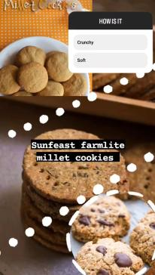
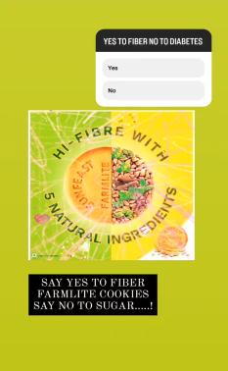
INSTAGRAM STORY

Slide 25


Slide 26

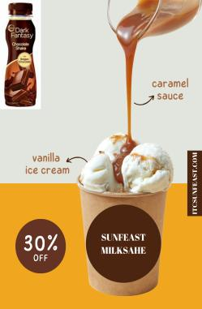
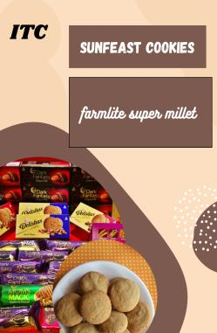
SOCIAL MEDIA AD CAMPAGIN

Slide 27
Advertising Goals: The choice of purchase is innumerable as thousands of companies are introducing newer products day by day. To cope with this situation people keep on acquiring knowledge regarding the products, prices, and substitutes. Companies that focus inward become blind to seismic changes in market, competition, distribution, media, and technology that are occurring outside. Mass markets are fragmenting into micro markets; multiple channels of distribution are replacing single channels. Customers are buying directly through Catalogues, Telemarketing, and the Internet. Price discounting and sales promotion are eroding brand loyalty. It is made an attempt to analyze the various types of brands and factors affecting purchase decisions. The study is based on primary data comprising 100 respondents. From the findings of the study, Consumer’s purchase decisions are influenced by mainly quality and they also purchase other varieties of sunfeast biscuits. I have generated leads blog posts, coupons, and online content. I have created quality backlinks where we have our link as high-ranking search engines which can be acquired by quality backlinks. Audience Targeting: This targets mainly children and the health cautious ones. Because it is rich in nutrition and very healthy for all types of people from childhood to old age people. AD Creation: It creates ads through digital marketing with the help of social media and through ad campaigns like (social media ad campaigns, email ad campaigns), etc.

Slide 28
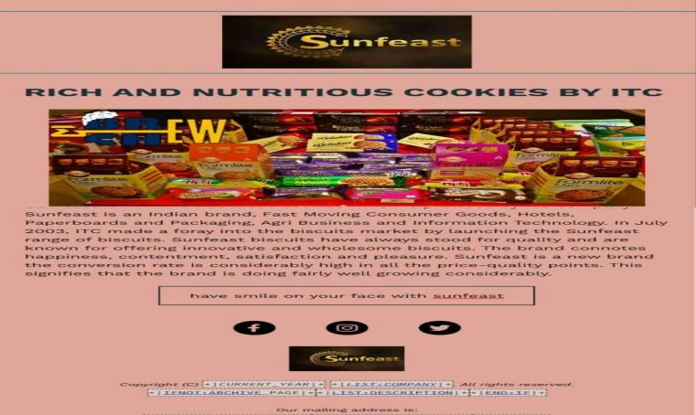
EMAIL AD CMAPAGIN-1(BRAND AWARENESS)

Slide 29
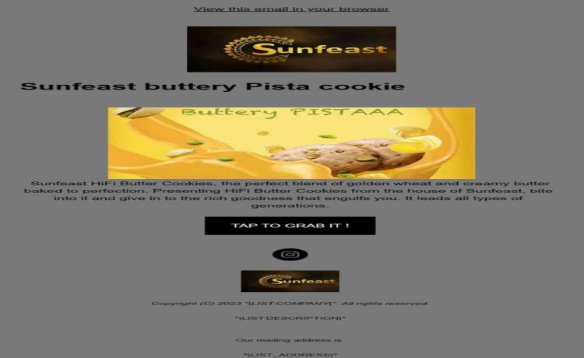
EMAIL AD CAMAPAGIN-2(LEAD GENERATION)

Slide 30
Content and curation is important task and role for the digital marketing of a particular brand. It increases the growth of the product and increases the awareness of the brand all over the world. It creates content through social media and reaches the audience’s needs and likes. But this process faced so many problems and consequences through the content creation process.

Slide 31
Thank You
TEAM ID: LTVIP2023TMID03880
TEAM LEADER : SUJAL PATWAL
TEAM MEMBER: SYED ABRAR
TEAM MEMBER: SAKSHI
TEAM MEMBER: VANGAPANDU TANUJA
TEAM MEMBER: RANABHERI KARTHIK

